Slide 1
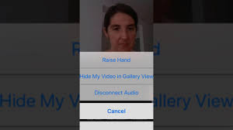
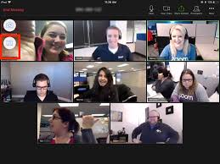
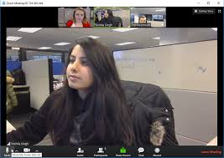
RULES OF THE ZOOM
Participants
Please activate your video webcam
Please remain muted until called upon
If using a phone for audio please self mute and unmute when called upon.
Utilize “chat” function
Utilize “raise hand” function
If the meeting is interrupted and ends, please wait 5 min and log in again
Gallery view will show all attendees
Speaker view will show current speaker and is view available on an iPad or tablet
This event is being recorded.
Desktop Control View
Tablet/Smartphone View

Slide 2
GRANT MANAGEMENT SEMINAR
DISTRICT 6580
WELCOME
2020-2021
Notes:
Welcome to the 2021-22 Grants Management Seminar. Participation in this webinar will qualify you for DGE Lance Eberle’s 2022-2023 Rotary Year which begins July 1.

Slide 3
19 District Grants Awarded for 23-24
Batesville Providing items for Children’s Asset room which
provides therapeutic activities for children
for families in the shelter for domestic violence.
Bedford Increase literacy by providing every 3rd grader
by providing book on history of Lawrence Cty.
Bloomington Planning and coordination of events to increase
work of protecting water quality at Lake Monroe. Bloomington North Purchase and installation of menstural health dispensers in community accessed organizations.
Bloomington Sunrise Support of events providing meals and childcare for refugee families and financial literacy.
Center Grove Purchase and assembly of over 16,000 meals for refugees affected by war in Ukraine.
Notes:
During our current Rotary year 19 clubs in our district received matching grants. Many of these club projects have not been completed yet. Here are some of the projects that are making a difference in your communities…..
Bedford $500 Buddy Benches
Bloomington $3000 Building exhibits for wonder & sprout lab
Bloomington North $3000 Flu Vaccines for the homeless
Bloomington Sunrise $1500 Support for Boys & Girls Summer Programs
Brazil $2853 Purchase of a Timpani for the concert band
Brown County $2000 Provide School Supplies to Uganda Orphanage
Columbus $2500 Expansion of the I Like Me Books to Other Grades
Columbus Sunrise $1500 Support of Teen Depression Group
Corydon $3000 Support of youth leadership program of HC
Evansville $420 Increase RYLA Participation
Evansville Morning $3000 Building a deck for Meth. Youth Home
Franklin $3000 Renovate food service area for Boys and Girls Club
Greenwood $2000 Fitness equipment for YMCA
Jasper $3000 Fund displays for deserving women’s
Martinsville $1400 Renovation of women’s Center
New Albany $1500 Assist with public art event
Salem $3000 Support for daddy daughter dance
Vincennes $2653 Purchasing books for 3rd grade classrom
As you can see, many of these projects involved coordination and cooperation with other city or county agencies or other service organizations and highlight the good we can do by working together.

Slide 4
19 District Grants Awarded Cont’d.
Clark County Instill water line services for 2 Habitat Houses.
Columbus Purchase of benches, designed and made by the C4 students for the People’s Trail.
Columbus Sunrise Providing food to youth with food insecurity in the Lincoln Central neighborhood.
Dubois County Supplying classroom with backpacks with supplies to care for and treat kids in the event of armed intruder or natural disaster.
Evansville Morning Co-sponsor a home build for Habitat for Humanity.
Evansville@night Renovation of a dressing room to create a secure and welcoming environment for girls in foster care.
Notes:
As you can see, many of these projects involved coordination and cooperation with other city or county agencies or other service organizations and highlight the good we can do by working together.

Slide 5
19 District Grants Awarded Cont’d.
Franklin Assist youth council in providing an art sculpture in the roundabout in front of the school.
Greensburg Place 4 AED’s at key park locations in Decatur County and assist with training. Greenwood Supplies and recruitment for Imagination Library Storybook Breakfast.
Martinsville Renovation of kennels and tubs for local animal shelter.
New Albany Big brothers/sisters recruitment event: provide meals and materials for event.
19 District Grants Awarded Cont’d.

Slide 6
19 District Grants Awarded Cont’d.
Terre Haute South Providing scholarships and a mobile education program to summer camp students k-5 to introduce them to the art of woodworking.
Vincennes Planting of large concrete pots lining the city center of Vincennes to create a welcoming environment.

Slide 7
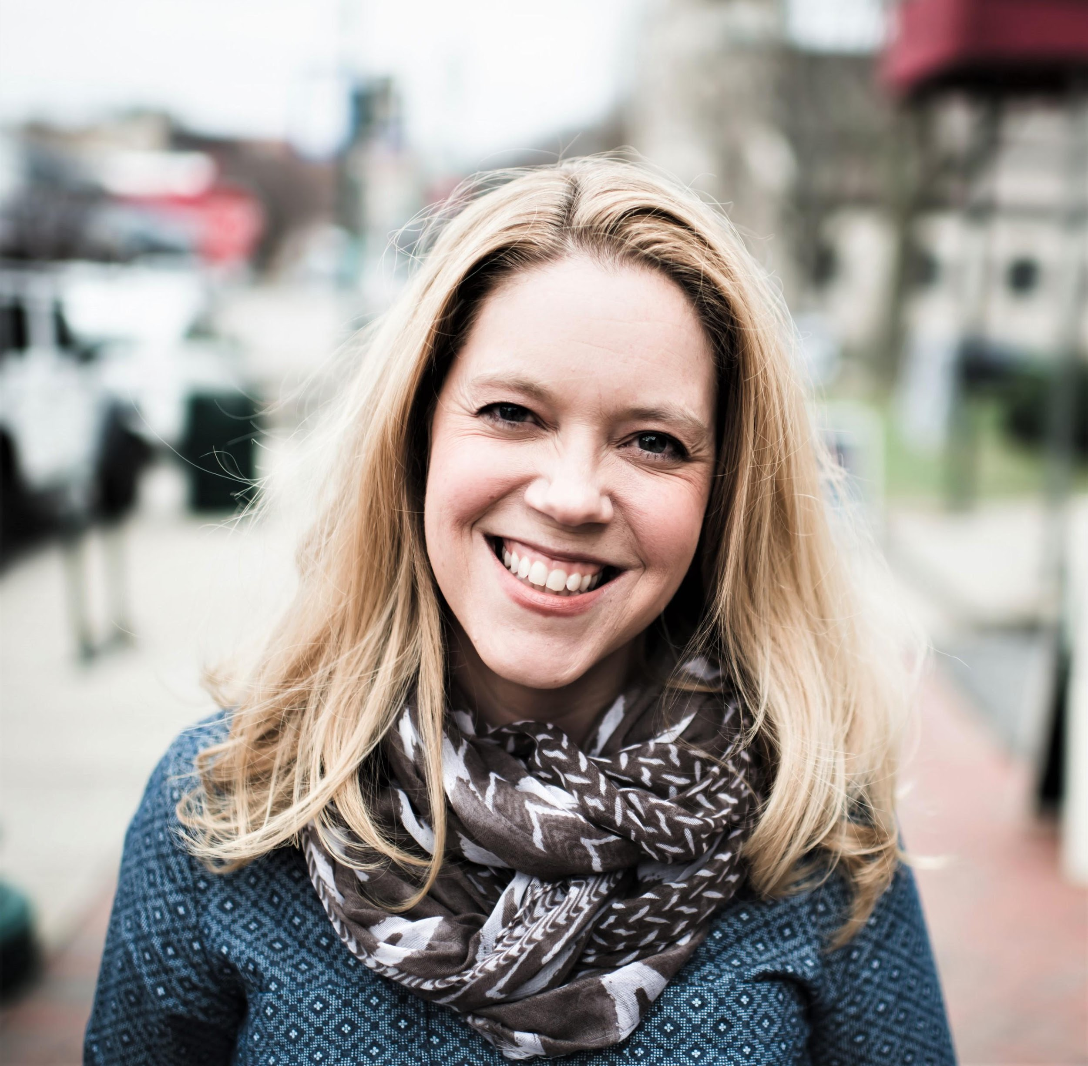
Welcome
Moderator
District Foundation Chair
PDG Jessika Hane
2021-2022
Notes:
Good evening, I am Past District Governor and District Foundation Chair Jessika Hane
We have brought you this Grants Training Webinar for several years now, even before the COVID 19 Pandemic. We have been very please with the convenience and efficiency in which this format is brought to all our participants. This is the first of two qualification webinars for the Rotary year 2021-22. the second webinar will be held on Jan 20, 2022__ Remember, part of the club qualification process in District 6580 is that two members of each Rotary Club that wants to do a District Grant must attend these webinars in their entirety. You should have received an email directing you to retrieve a copy of the slides which The supporting documents are also on the District web site at www.rotary6580.org. If you have not retrieved those you can do so after the completion of the webinar.
If you are having technical issues you can e-mail or call .______________________________________
The webinar is divided into sections and there will be a short quiz at the completion of each section to ensure that you understand the material presented.

Slide 8
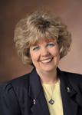
Welcome
Annual Fund Chair
PDG Peggy Peter
2021-2022
Notes:
Our 3 presenters for tonight are Past District Governor and current Annual Fund Chair, Peggy Peter.

Slide 9
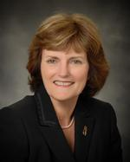
Welcome
District Grants Chair
PDG Bettye Dunham
2021-22
Notes:
Past District Governor and current District Grants Chair, Bettye Dunham

Slide 10
PURPOSE
Impact of The Rotary Foundation
Understanding The Rotary Foundation
Understand how to manage District grants
Learn stewardship expectations
Prepare clubs to implement the MOU
Qualify clubs to receive grant funds
Understand why grant funds are available
2021-2022
Notes:
The goal of this webinar is the help you understand the impact of the Rotary Foundation, increase your understanding of The Rotary Foundation, explain how to manage your district grants, help you understand what is expected of you, explain what forms need to be completed and help you to better understand the district grant process and of course, to qualify your club to receive a district grant.

Slide 11
AGENDA
Introduction and Impact of The Rotary Foundation – Jessika Hane
Designing a Grant Project—Peggy Peter
Applying for and Implementing a Grant – Bettye Dunham
Oversight and Reporting—Jessika Hane
Notes:
Our agenda for tonight is as follows:
Peggy will be discussing the design of a grant,
Bettye will be discussing the application process and implementation of a grant and
I will be finishing up with oversight and the reporting requirements.
I will be providing a little background on the Foundation, assisting with the section quiz and generally trying to keep out of everybody’s way in the process

Slide 12
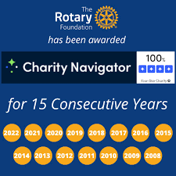
INTRODUCTION
Notes:
As you are probably aware, we are have just celebrated the 100th anniversary of the creation of The Rotary Foundation through the 2016-17 year. So before we jump into tonight’s program, we thought it would be nice to share some information about the Foundation which helps us serve so many people throughout the world. These numbers are from the 2020 annual report.
From its first contribution of $26.50, the Foundation’s assets have grown to approximately $1 billion, and $4.9 billion have been spent on programs and projects, transforming millions of lives across the globe.
over 3 billion children have been immunized against polio, reducing cases of the disease by 99.9 percent.
More than 1300 Rotary Peace Fellows have been trained to resolve conflict, deal with the aftermath of war, and promote peace.
Hundreds of thousands of people now enjoy access to clean water, heath care, and education, thanks to Foundation humanitarian projects.

Slide 13
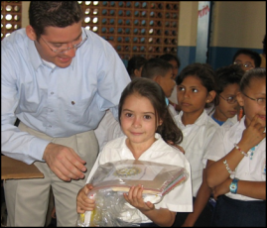
SUPPORTING THE ROTARY FOUNDATION
PolioPlus Fund
End Polio Now
Annual Fund
For Support Today
Endowment Fund
To Secure Tomorrow
2020-21
Notes:
Rotarians support our Foundation through:
The PolioPlus Fund, dedicated to global polio eradication
The Annual Fund, primary source of funding for Foundation grants and activities
The Endowment Fund, which supports the Foundation in perpetuity

Slide 14
POLIO ERADICATION
TO DATE ROTARY’S ACCOMPISHMENTS
3 Billion children have been vaccinated in 40 countries
19 Million children were not stricken with polio
1.5 Million children did not die from polio
All countries except Pakistan & Afghanistan are “Polio Free”

Slide 15
ANNUAL FUND
Primary funding source for Foundation grants and activities
Supports local and international grants through the SHARE system
Contributions are credited to donor’s club and applied to club’s goal
2020-21
Notes:
Contributions to the Annual Fund support local and international grants and activities through the SHARE system.
Under the SHARE system, when you make a contribution to the annual fund, it is held for three years, then 50% of your contribution is returned to the District to the used for programs such as District Grants and Global Grants of the district, the other 50% is used by the Foundation in the World Fund for programs such as Global grants.
Contributions are credited to the individual donor and the donor’s club and counted toward the club’s and district’s Annual Fund goals.

Slide 16
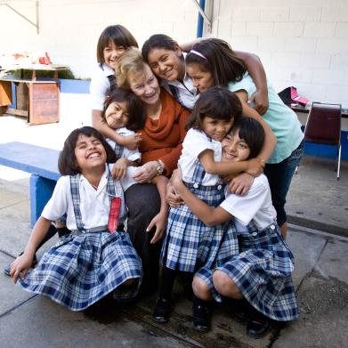
ENDOWMENT FUND
Contributions are professionally invested
Only the earnings are spent
2020-21
Notes:
Gifts to the Endowment Fund are held in perpetuity as part of an endowment. They are professionally invested, with a portion of the earnings used each year for purposes specified by the Trustees and the donors.
The Endowment Fund offers donors a way to create their own lasting legacy through Rotary.

Slide 17
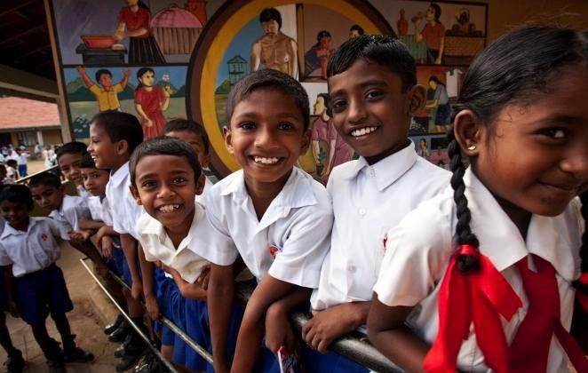
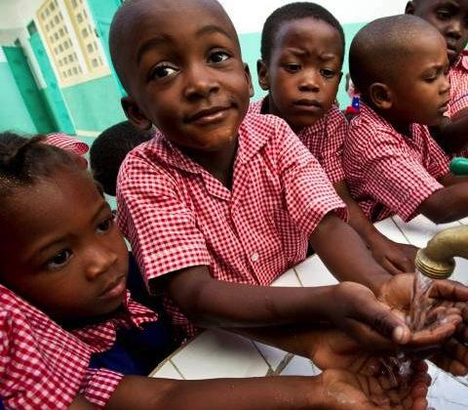
HOW WE FUND PROGRAMS – SHARE SYSTEM
47.5% District Designated Fund (DDF)
47.5%
World Fund
Notes:
To review: when we contribution to Annual Fund – SHARE, fifty percent (50%) of our contributions come back to our district through District Designated Funds (DDF) in three years to spend on educational and humanitarian activities chosen by us such as District Grants that are used for projects in our local community and Global Grants.

Slide 18
DISTRICT 6580 GIVING 2022-2023
ANNUAL FUND GIVING –
$191,973
PER CAPITA GIVING –
$129.36
YTD-$51,361

Slide 19
DISTRICT GRANTS 2024-2025
DISTRICT DESIGNATED FUNDS
DISTRICT GRANTS
$38,240

Slide 20
SESSION POLL
Notes:
Question 1 Multiple choice
Have you ever given to The Rotary Foundation?
-Once
-Several Times
-Monthly
-Never

Slide 21
SESSION 1
DESIGNING A PROJECT
Peggy Peter
2020-21
Notes:
Now onto our grants training program.
As promised, PDG Peggy Peter will lead us off with a discussion of the designing of a District Grant Project.
Peggy it is all yours.

Slide 22
LEARNING OBJECTIVES
Identify best practices for designing a project
Develop a plan to implement your project
Notes:
We will discuss best practices for designing a project and how to develop a plan to implement your project.

Slide 23
SUCCESSFUL DISTRICT GRANT PROJECTS
Meet community needs
Have an implementation plan
Maintain proper stewardship of funds
Note: Funded district grants for 2022-23 can be found on the District website.
Notes:
Speaking points:
Beneficiaries are more likely to support and participate in a project that addresses the needs of a community and has a sustainable outcome – one that will continue after the funds have been spent.
Rotarians should partner with the community and organizations with technical expertise; however, projects must be managed by Rotarians.
Working together means more than financial participation; it also means using each partner’s expertise to implement the project or activity.
The implementation plan should include an achievable project timeline and should be shared with partners and beneficiaries.
By establishing a financial management plan before applying for grants, clubs ensure that they will have processes in place to manage funds before any money is received.

Slide 24
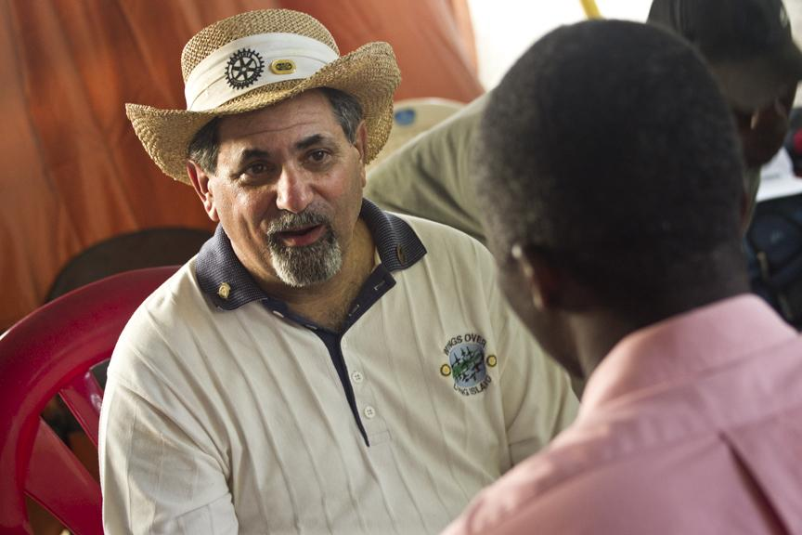
NEEDS ASSESSMENT
Base projects on communities’ needs
Determine availability of
club and partner resources
Talk to the community
Notes:
Speaking points:
Asking members of the community what they need and what strengths they bring to the project results in greater support and involvement, which leads to a more sustainable, lasting impact.
Once the needs are identified, your club should consider which can be addressed with the resources, skills, and availability of your club and its potential partners, including other Rotary clubs, districts, The Rotary Foundation, and non-Rotary organizations.
Continue involving the community during the selection of the project and its planning and implementation.
The Rotary publications Communities in Action and Community Assessment Tools offer information and resources for conducting a community needs assessment.
Discussion questions:
Has anyone been involved in conducting a community needs assessment? What was your experience?
What successes or challenges can you share?

Slide 25
PROJECT PLANNING
Form a three-person grant committee
Assign roles
Make an implementation plan
Establish a budget
Have a contingency plan
Have a document retention plan
Inform your club of project application
Notes:
Speaking points:
Rotarians must manage all projects that receive funding from The Rotary Foundation.
Both the host sponsor and international sponsor must have committees of three Rotarians to manage the project.
Roles and responsibilities should be assigned to everyone on the committees.
Create a plan for managing funds and implementing the project.
Develop a budget that includes details and a timeline for the purchase and distribution of goods, training, and any other activities.
Consider your liability for the project, ensure that your club is protected, and have a contingency plan in case something goes wrong.
Set up a process for retaining documents related to the grant (see club MOU section 6) before funds are received.
Discussion questions:
Who would you include on the three-person project committee?
What systems do you use to store grant records?
Does everyone on the committee have access to the records?

Slide 26
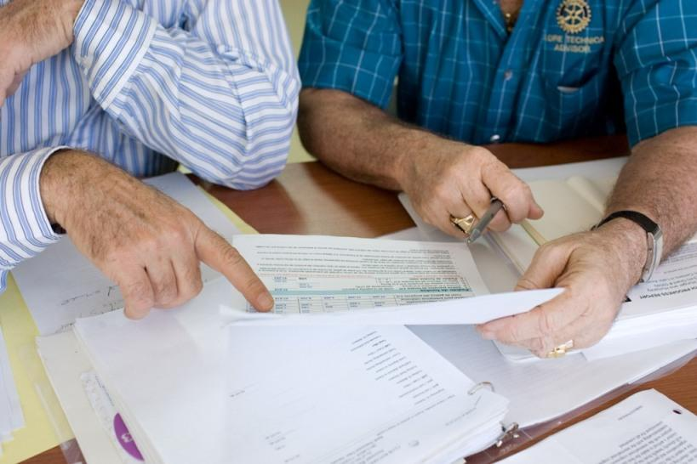
CREATING A BUDGET
Realistic and Comprehensive
Reasonable prices with competitive bidding
Clubs keep records
of submitted bids
Disclose conflicts of interest
Notes:
Speaking points:
A budget should be realistic and comprehensive to ensure adequate funding.
When choosing a supplier, Rotarians should use a competitive bidding process to ensure that they get the highest quality goods at the best prices.
Clubs should keep records of any submitted bids.
Clubs must disclose any potential or real conflicts of interest related to the budget.
Discussion question:
Has anyone been involved in a competitive bidding process?

Slide 27
JUDGING CRITERIA
Project is meaningful to the community and benefits many
Rotarian involvement (family of Rotary and Community/ies)
Public Relations Plan for the project
Application preparedness
Level of club giving to TRF over the previous 3 years (2020-2023)
Additional points may be given for uniqueness or innovative approach

Slide 28
Session Poll
Notes:
Thank you Peggy. Lets look at the polling questions. Please respond the questions when I prompt you to do so.
Question 2
Does a Club’s level of giving to the SHARE program of the Rotary Foundation’s Annual Fund play any part in deciding which clubs receive a grant?
True or False
*True
Question 3
District grants can be used for all of the following except?
Scholarships
X Polio Vaccines
RYLA
Youth Exchange

Slide 29
SESSION 2
APPLYING FOR AND IMPLEMENTING A GRANT
Bettye Dunham
2021-2022
Notes:
In Session 2, PDG Bettye Dunham will be leading a discussion of Applying for and implementing a grant, Bettye?
Welcome everyone. This is Bettye Dunham, District Grants Chair. In this session you may hear key points repeated as we go through the application. Please understand this is done to highlight areas that might have been confusing or not understood in past grant cycles. Some of you will be familiar with grant processes and this will all seem redundant and duplicative. However please be aware that some of you are new to grant writing and need the additional clarification. Also, every grant process is different in design, so this training is to help you know the focus of the District and TRF.

Slide 30
LEARNING OBJECTIVES
Write a successful grant application
Understand grant financing
Notes:
We have two main objectives:
writing a successful grant: It is our hope that by having a good understanding, through this session, of what is needed for a successful grant; the information we are looking for in the application and the assurances we are looking for in how the grant is to be implemented, that we can have a smooth process and limit the number of calls needing to be made for clarification and the best decisions can be made on how these grants are funded for the greatest impact to our district.
2) Understanding grant financing: This has been an area in past grant cycles that has been confusing so we want to spend time on this.

Slide 31
APPLYING FOR DISTRICT GRANTS
Email application to Bettye Dunham by May lst
Applications become part of the spending plan submitted to RI from our District
Grants are approved by RI as a package
Clubs must plan for District Grants
Common reporting date
Notes:
The deadline date is firm. Please don’t ask for extensions because in being ‘fair to all concerned’ we must have a definite cut off.
The Grants committee will review the grants when they are submitted and we will make the initial decisions on awards. However the full grant package or spending plan then goes to RI and they must give approval for the spending plan before we are authorized to release funds. That is the reason why we cannot give a definite date for when the club will receive the funds because we must wait for this approval.
You will notice that planning is talked about throughout this session. We stress the importance of planning. It is important to know specifically not only how Rotary’s funds are used in the project but the overall scope and specifics of the project. Projects will not be rated highly if it is a project where we give you a check, you give a check to the partners and Rotary is not intricately involved.

Slide 32
APPLICATION & FORMS
Application for grants funded during the 2024-2025 Rotary year must be received by May 1, 2024 and must be in Word document format.
Applications reviewed by the District Grants Committee and the staff of The Rotary Foundation.
If approved, the clubs will receive a check for the amount of the grant (around August 1st).
Notes:
-Did I mention the deadline date: May lst.
-Please submit emailed documents in Word format.
-Again, we will not have a ‘definite’ date for release of the funds. Please do not commit in a partnership project to have the funds available before around the first of August as we cannot commit to this

Slide 33
APPLICATION
Items that must accompany the application:
Signed copy of the Club Memorandum of Understanding (MOU)
Completed & signed copy of Grants Management Compliance Questionnaire
Completed Transferring Custody of a Bank Account Form
Forms available at www.rotary6580.org under Foundation and then District Grants 24-25 .
Notes:
These three documents on found on the website. These are required by TRF and MUST accompany the application by the deadline date.
-the MOU lines out the qualifications and the responsibility of the club leadership to assure proper grant management. These points will be highlighted throughout this training but your signature here documents your understanding of this.
-Compliance Questionnaire: The main point of this document is the detail of the financial management plan and the documentation retention needed. Judy will talk about this in more detail in Session 3.
-Transferring custody of a bank account. This form is usually one that creates many questions. The rationale for this form is because in the past club members that were responsible for the finances have left and there has been no trail or accountability for the funds that have been disbursed. This not only puts that club in jeopardy related to grants but the whole district as you will see through upcoming slides. This form is designed to help you assure there is a process in place if this happens.

Slide 34
APPLICATION: DISTRICT GRANT RULES
District grants: dollar-for-dollar matching grant on the following basis:
Not less than $250 and no more than $3,000
Funds used for local community service and international projects
Projects completed within the Rotary year granted
Notes:
Note:
DOLLAR FOR DOLLAR: This means if we grant you $500 you must match it with $500. The ‘matching’ funds can come from funds the clubs have raised through events, from other community funds given for the project, but these must come through the Rotary Club to be counted towards the match.
Your application can not be for less than $250 or for more than $3000.
These funds can be used for BOTH district projects AND international projects. You might however want to consider based on the size of your project and the funds needed whether to apply for a global or district grant if it is an international project.
The project must be able to be completed within the year granted. Again, for international projects this might mean you need to consider global rather than district since this is not a restriction on global grants.

Slide 35
APPLICATION: DISTRICT GRANT RULES
Submit a Final Report within 30 days of the completion of the project
Deadline: March 31, 2025
If the project is not completed by March 31st submit an interim report by March 31st on the District Grant Report covering the following:
-all activity to date
-detailing any delays
-assurance of the completion of the project before August 31st
Notes:
This slide covers reporting which is mentioned throughout. As soon as your project is complete send a report (with pictures). On March 31st we must have heard from all projects. If your project for some reason cannot be completed by March 31st then you need to submit an interim report detailing all activities, reason for delays, and assurance of completion by August 31st. These dates are critical because they impact the ability for our district to get grants in the following year.

Slide 36
APPLICATION: DISTRICT GRANT RULES
The use of District Grant funds must:
Promote participation of Rotarians in the implementation of the project
Not involve the establishment of a permanent foundation, trust, or permanent interest-bearing account
Not directly benefit a Rotarian; an employee of a club district or other Rotary entity, or others connect to Rotary through any family connection
Not to be used to reimburse clubs/districts for projects already undertaken and in progress, or completed
E. Not be used to fundraise for match or to pay for staff
Notes:
This slide speaks to the terms and conditions of the grants regarding what is not allowed. Also note that ‘participation of Rotarians’ is a theme throughout and it is important to make sure this is covered in your grant. Simply ‘writing a check’ to another partner will not get high points. There must be involvement of Rotarians either in fundraising to secure the match, or actually carrying out or implementing the project OR both.
Regarding what cannot be covered Please note B. C., and D.
Cannot be used to start to contribute to a foundation or trust
Cannot benefit a Rotarian, an employee of a club or family members of Rotarians. This will be discussed again later as well.
Cannot go towards projects already completed or in progress. MUST be a NEW project. It can be ‘similar’ in nature to another project but not the same; i.e. if your club regularly does I Like Me books funds could not go for this, however if your club wanted to do dictionaries for children this would be different.

Slide 37
APPLICATION: ELIGIBILITY CHECKLIST
Have your President & President-elect signed and included a Memorandum of Understanding (MOU) ? ___No ___ Yes
Have you included the Grants Management Compliance questionnaire? ___No ___ Yes
Have you completed the Transferring Custody of a Bank Account Form AND the copy of the Grants Bank Statement showing the club’s portion of the funds on deposit? (Not required for grant awards of $1000 or less.) ___No ___ Yes
Did two members of your club participate in the webinar on grants management seminar this year? Names: ________________________, _________________________ ___No ___ Yes
Notes:
We added this to the application this year at the suggestion of a PDG after he talked with people in other districts. As we go through these next slides it lays out the basic eligibility for applying and what MUST be in place for your project to be considered.
The first 3 are the three forms that must accompany the application
#4 is attendance at this webinar. The reason for two is because, again, we often lose members or they are not available for assistance with the grant and then the club struggles and we struggle in getting everything in place.

Slide 38
APPLICATION: ELIGIBILITY CHECKLIST
Have you recorded an Annual Fund giving goal for your club on Rotary Club Central on the RI website? www.rotary.org ___No ___ Yes
Have you notified the Governor-elect of the name of your Club Foundation Chair? ___No ___ Yes
Have you paid all your District & RI dues that are currently due and payable? ___No ___ Yes
Have you received any Global or Community Grants for which you have not filed final reports? ___Yes ___No
a. If yes, is your club current with all interim reporting requirements? ___No ___ Yes
Is the project new to your club? ___No ___ Yes
Notes:
#5 & 6: The reason for these requirements is because the funds that make the grants possible come from the donations by members to the Foundation 3 years ago therefore the support of the Foundation is a consideration.
#7: If you do not know the answer to this please check with the District Treasurer: Jeffrey Berger.
#8: If you have an outstanding report from the 16-17 grants this could impact your ability to apply for these grants.
#9: Discussed earlier

Slide 39
APPLICATION: ELIGIBILITY CHECKLIST
Will your club be matching the amount requested? ___No ___ Yes
Is the project free of any conflict of interest or the appearance of such? (See page 2 Rules and Regulations.) ___No ___ Yes
Would your club still complete the grant if they do not get the full amount? ___No ___ Yes
And finally, have you signed this application? ___No ___ Yes
Are you current with your federal and state tax filing?_ __No __ Yes
If any of your responses are NOT in the RIGHT HAND COLUMN, please stop and contact the District Grants Committee.
Notes:
#10: Discussed
#11: Conflict of Interest will be further discussed later in this session
#12: If we are unable to give the full amount requested could you still do parts of the project? Think carefully here. We know you do not want to say you can do with less because you feel that will influence what you get. However it could also influence that you don’t get any funding if you say no. We try to take the money available and spread it to the best impact of the District but there are many great projects that come in and we will likely not have enough funding to do all of them so decisions must be made.
#14: Check with your club treasure to determine this. If not then you need to get in touch with David Reinhardt right away.

Slide 40
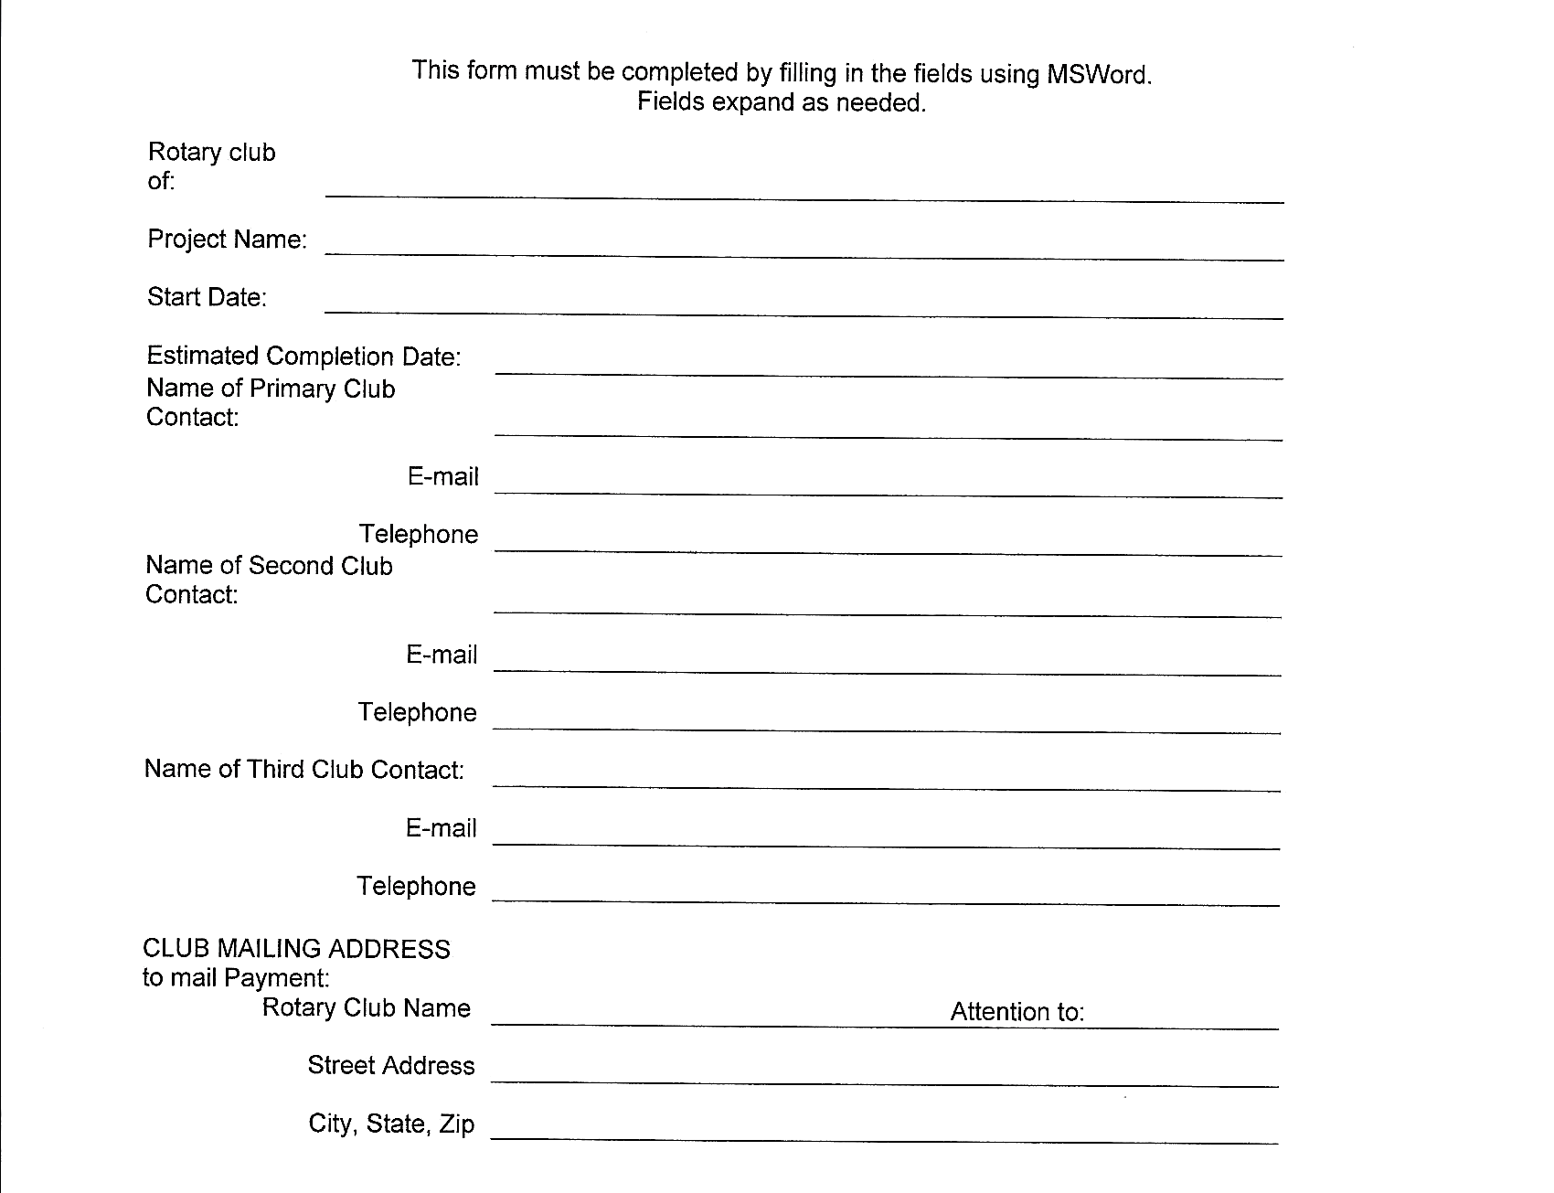
APPLICATION
Notes:
Need at least three people in your club that are thoroughly knowledgeable about the grant and how it will be implemented. Note: at the bottom it ask to whom you want the grant check mailed. Club treasurer

Slide 41
APPLICATION
Briefly describe the project, its location, and its goals and activities and how it will be sustained.
Describe how the project will benefit the community and/or improve the lives of the less fortunate, who will benefit by the completion of the project, and how many people in the community will benefit.
Describe the nonfinancial participation by Rotarians in the project (i.e., How many Rotarians will be involved and how they will be involved).
How will the general public know this is a Rotary-sponsored project; i.e. how will it be promoted and publicized? Please provide details, e.g., publicity in a newspaper or display of the Rotary wheel.
Notes:
This is the meat of the application:
Please be as detailed as possible on this. If your project is part of a larger project please outline the full project and what part your piece plays in this. Example: If the project is renovation of a community food kitchen and your club is providing the oven then talk about the larger project of renovation and how your piece fits into this.
How will this project improve lives: who will benefit (again, be detailed about the parameters; does it only apply to a certain age, a certain income level, etc.) Also please try to give an estimate on the number of people that will be impacted; i.e. in the project to renovate the food kitchen, how many families are estimated to use these services each month/year? Sometimes it may be more difficult such as working on a trail for the park but here you could include things such as the population of the community that will access the park.
Non-financial participation by Rotarians: Again, we do not simply want to be writing a check for a project. The more ‘hands on’ a project can be the better and higher points.
Publicity: As Rotarians we constantly say we don’t let people know well enough how much we help our communities. This is important because the more we let the community know the more that will bring people to Rotary to join and then the more we can give back to others.

Slide 42
APPLICATION
Cooperating Organizations – If the project involves a cooperating organization, please provide the name of the organization below and attach a letter of participation from that organization that specifically states its responsibilities and how Rotarians will interact with the organization in the project. By signing this application, the Rotarian sponsors endorse the organization as reputable, responsible, registered with the project community, and acting within the laws of the United States.
Name(s) of Cooperating Organization(s) and Contact Person
Notes:
#5: We think partnering with others in the community toward a project is a great idea and if you are going to do this we need a letter from the other entity(ies) outlining their role in the project and how Rotary will coordinate/cooperate with them. A KEY here is that your members are taking the responsibility that this/these organizations are reputable and responsible.

Slide 43
APPLICATION
6. Identify the primary area of focus aligned with RI:
Peace and Conflict Resolution ___
Water and Sanitation ___
Basic Education and Literacy ___
Disease Prevention and Treatment ___
Maternal and Child Health ___
Economic and Community Development ___
Environmental ___
Other (explain)_____________________
Project Duration: Projected Project start date: ___________
Projected end date: ___________
Notes:
Areas of Focus: All projects will not necessarily fit into these categories. This is something however that TRF wants to see so there is an ‘other’ category at the bottom.

Slide 44
APPLICATION
9. Enter Budget Information: Income Sources
Sources of Income | Amount
Amount of District Grant Funds Requested: (Funds must be matched by the club)
Club matching funds:
Other Funding Sources (please specify):
Total Budgeted Income:
Notes:
BUDGET information: This refers to the discussion earlier on One-to-one match. If you are asking for $500 then your club needs to put up $500. Other funds can be part of the project and it is good to include these here but you still need to indicate how the match will be raised for your amount: ie An example here was Brown county in a prior years: they asked for $3000 in grant request and then indicated in this section that their Rotary Club voted to give $3000 to the project thus making it $6,000. In addition this would be matched by the Brown County Community Foundation for another $3000 from a Lily Grant. Some clubs indicate they will be fundraising for the money and put in some descriptors as to how this is planned.
If you are using other funds from your community for part of your match then this must come through your club; i.e. If in the example above you intended for funds from the Community Foundation to be part of your match to the district grant funds then these funds would need to be awarded to your club and come through your club bank account.

Slide 45
APPLICATION
PROJECT EXPENSES: REQUIRED (please attach an additional sheet if you need more space):
Expense Items (please be specific) | Cost
(NOTE: Best practices is for vendors to be paid directly by the club.)
Total Budgeted Expenses:
2022-2023
Notes:
Expenses: This is where you detail what the money will be spent on. Again, it cannot just be that you are giving a check for the project. You need to lay out where the requested and matched funds will go. What we mean by ‘best practices’ is that even though you may be combining your funds with others for a project it is ‘preferred’ for Rotary’s money to be shown in the form of check payments directly to the vendors: Ex: back to Brown county’s project with Helping Hands…the best practice would be for Rotary to pay directly for the lumber and materials needed to renovate the building rather than giving a check to Helping Hands to do this.

Slide 46
APPLICATION
As President and President-elect of the Rotary Club named above, we hereby affirm that the club’s board has voted to undertake this project as an activity of the club and that the club’s officers and directors have read, understand and agree to abide by the Club Memorandum of Understanding. In consideration of receipt of these grant monies, we agree to implement the project as described in this application and to complete this project in a timely manner and to submit a final report within 30 days of completion. Failure to complete the project or to file timely final report will disqualify this club from future district or global grants. We also affirm that all information in this District Grant Application is true and accurate, to the best of our knowledge.
Notes:
#10: the main focus of this slide is to drive home that the project must be implemented as described in the application. If there are deviations to this then the club needs to get in touch with the grant committee for approval AND the grant committee then must get in touch with TRF to get their approval for the change. If you do not and the money is not spent as described the committee will ask for the funds back. We are charged with following through on what TRF has approved.
AGAIN: if reporting is not done as indicated the club can be disqualified from any future grants.

Slide 47
APPLICATION
*Signatures are not required if submitted via e-mail with both parties listed in the address line.
Send completed application and other required forms to: Bettye Dunham: bdunham@rauchinc.org
Club President |  |  | Club President-Elect
Name |  |  | Name
Signature or e-mail address* |  |  | Signature or e-mail address*
Date |  |  | Date
Notes:
Signatures….signatures…signatures….TWO…no need to say more.

Slide 48
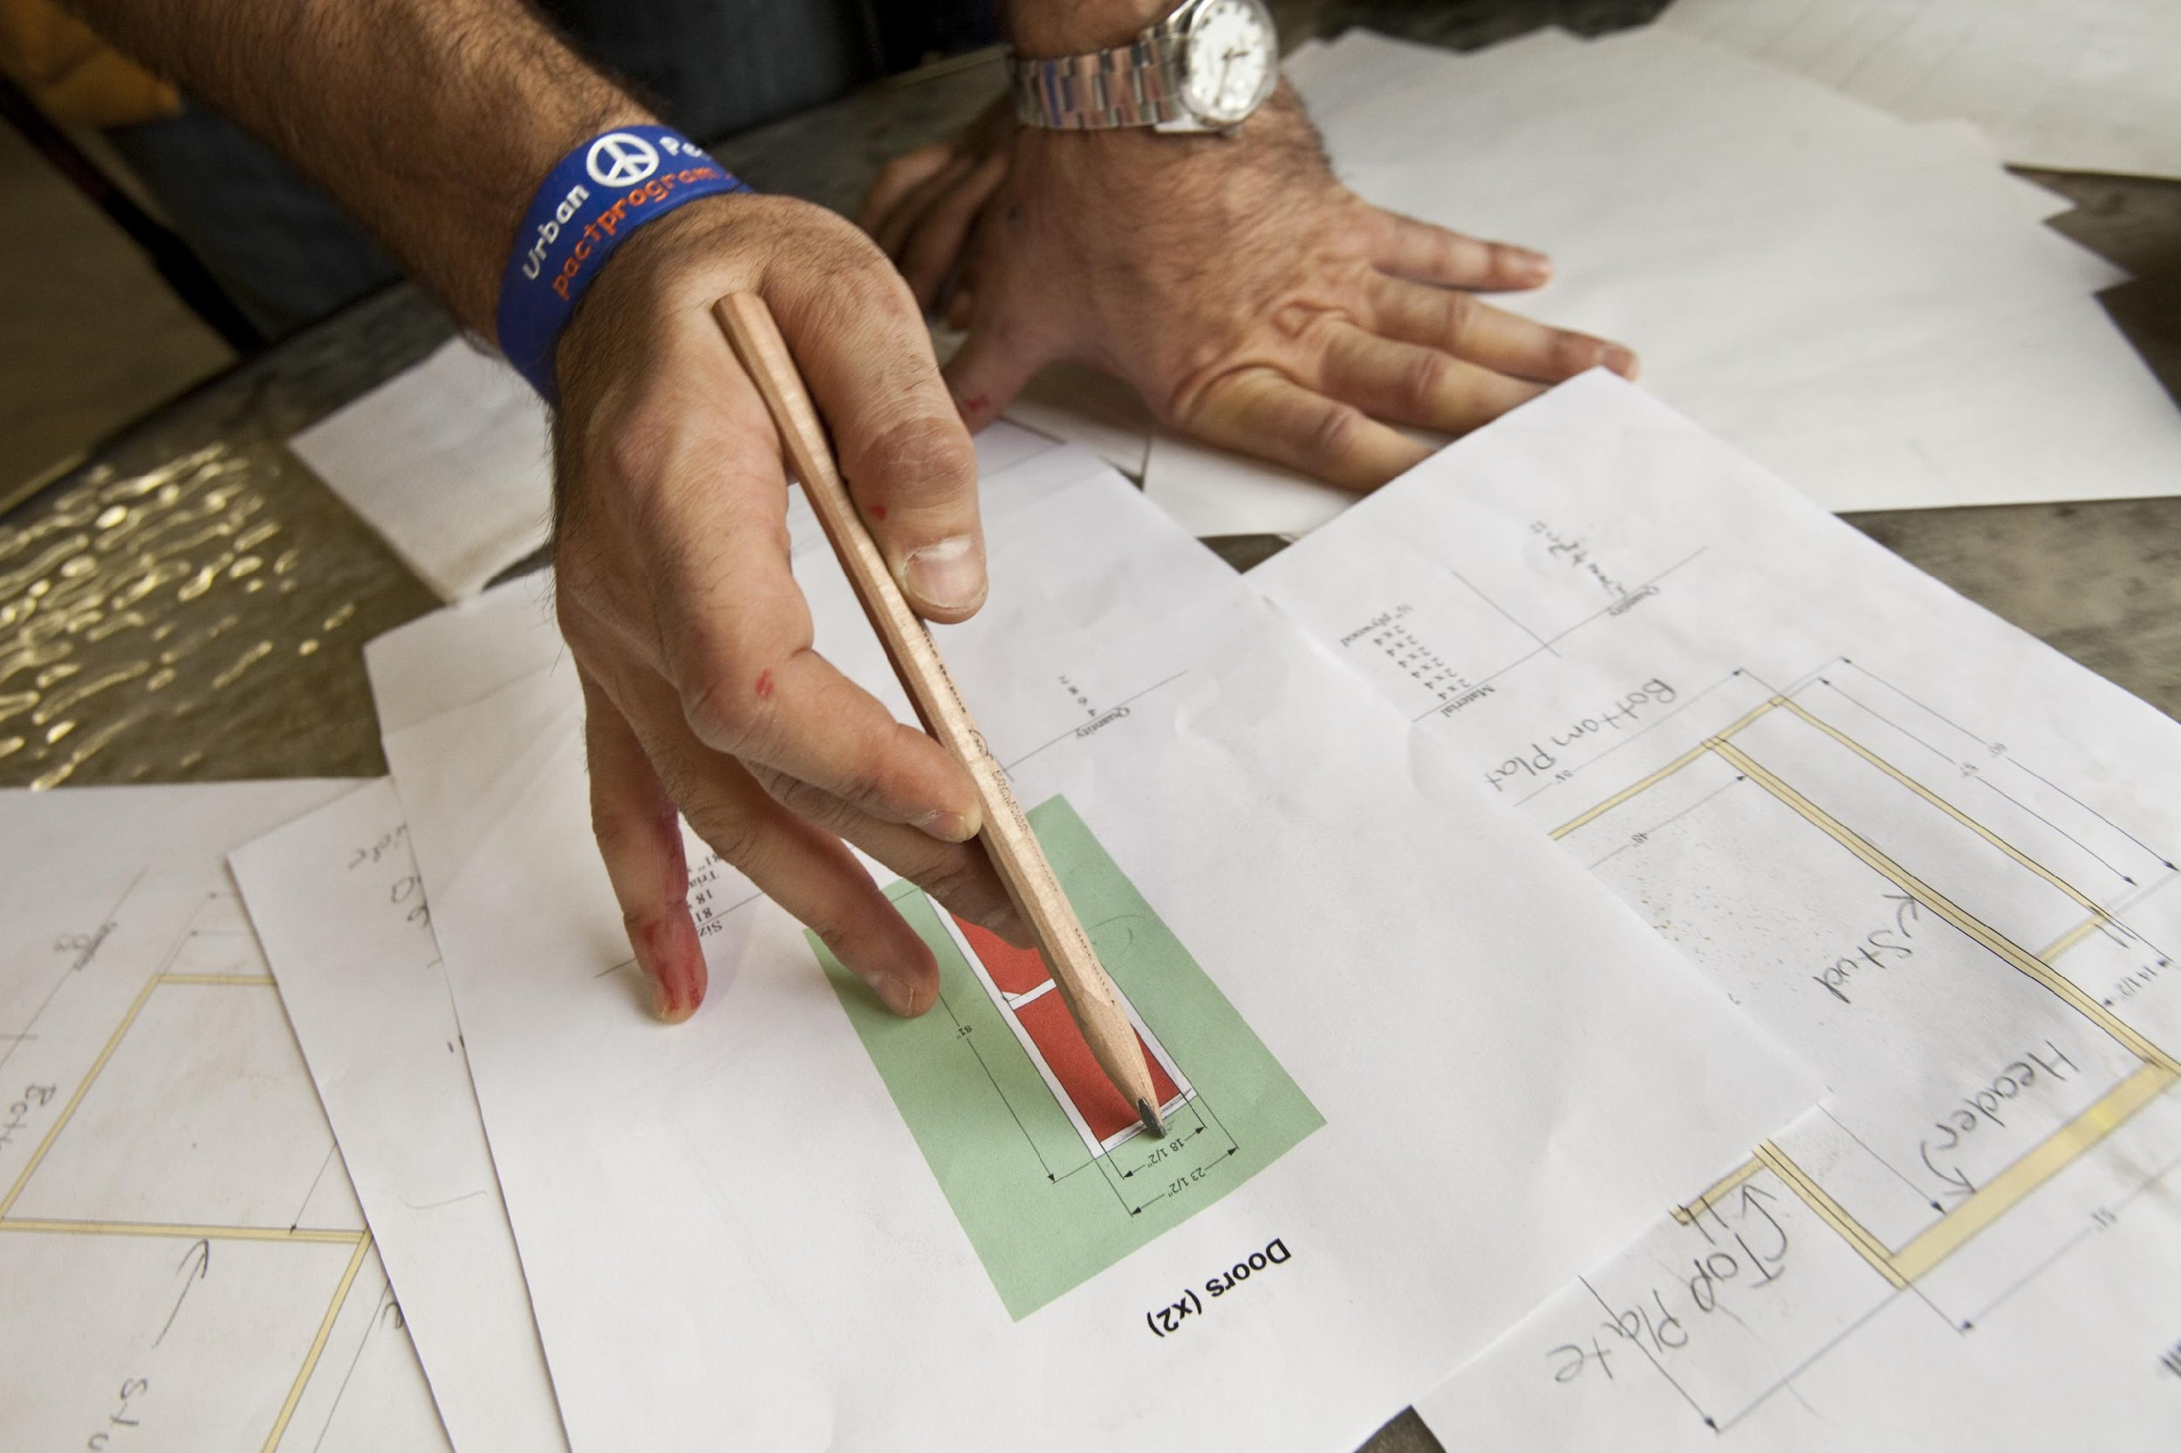
CONFLICT OF INTEREST
Exists when a Rotarian benefits financially or personally from a grant
Benefit can be direct to a Rotarian or indirect to an associate of the Rotarian
Notes:
This is pretty clear. Cannot benefit a Rotarian or a family member of a Rotarian. ONE clarification here: For example: If you were purchasing books and a Rotarian had a book store. If you get three prices on the books and the Rotarian quote comes in as the best quality and/or the lowest, then the Rotarian can be selected. However if not then you could not buy from the Rotarian. In these cases the KEY will be to have the documentation of all the bids and be able to show the justification for purchasing from the Rotarian. Otherwise it could not be proved that it wasn’t’ done to benefit the Rotarian.

Slide 49
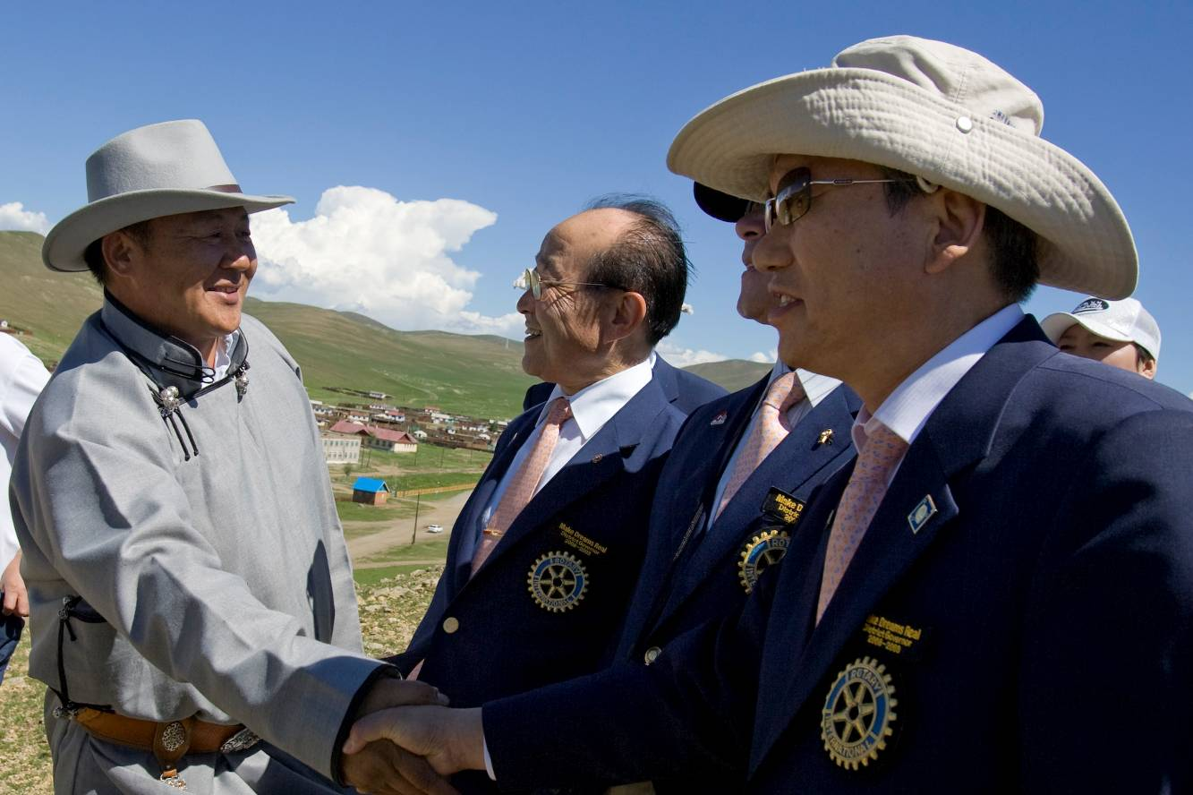
IMPLEMENTATION
Communication
Financial management plan
Record keeping
Notes:
Make sure to communicate to your club
Make sure to have a financial management plan
Make sure to keep good records!

Slide 50
Session Poll
Notes:
Thank you Bettye.
OK we are now ready for our next set of polling questions.
Question 4
The following must be included with the application except:
-Grant application
-MOU
-Grants Management Compliance Questionnaire
X Listing of previous grant history
-Transferring Custody of a Bank Account Form
Question 5
All of the following are true about grants except:
-Must be at least $250 but no more than $3,000
X Grant Funds are matched at 2:1 (Matched at 1:1)
-Grants cannot be granted for projects already undertaken by the club
-Grants are due by May lst
-Clubs cannot change the use of the grant funds without approval from the District
Question 6
Do you need to contact the grants committee if the scope of your project changes in any way?
True or False
*True

Slide 51
SESSION 3
OVERSIGHT AND REPORTING
Jessika Hane
2022-2023
Notes:
We are now ready for our final session of the evening. In this session our PDG and Foundation Chair Jessika Hane will be discussing the important process of oversight and reporting.

Slide 52
LEARNING OBJECTIVES
Identify best practices for managing funds and record keeping
Identify which documents need to be retained
Understand reporting requirements
2019-20
Notes:
Greetings, We are getting close to the end of the session so I will be brief. I am thrilled that virtually all of our District clubs are participating in this webinar and will be qualified to apply for a district grant. The Foundation is the way that we do good in the world for nearly 100 years which is wonderful when we think of all the good that has been done through the work of The Foundation.
We will be hoping to learn best practices for managing funds and record keeping; this, of course, is a review for most of us.
We hope to learn which documents need to be retained and to understand reporting requirements.

Slide 53
STEWARDSHIP
Stewardship is the responsible management and oversight of grant funds, including:
Report any irregularities
Rotarian supervision
Financial records review
Oversee funds
Submit reports on time
Notes:
Speaking points:
Clubs must follow standard business practices for managing these funds.
It’s important to review financial records to confirm proper use of funds. Good stewardship is achieved by putting systems in place that create clubwide awareness of the use of funds. Widespread knowledge helps prevent mismanagement.
Any irregularities or misuse of grant funds should be reported immediately.
Submit timely, complete, and accurate reports to demonstrate good stewardship of funds to Rotary and all grant partners.
A club’s level of oversight, transparency, and accountability in managing Rotary grant funds affects donors’ confidence in giving to The Rotary Foundation and working with that club on future projects.

Slide 54
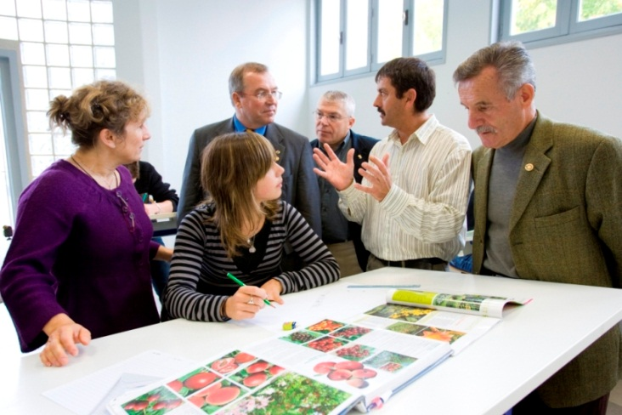
FINANCIAL MANAGEMENT PLAN
Distributing funds
Use checks or bank cards to track funds
Detailed ledger
Pay vendors directly
Be aware of any local
laws (i.e. zoning, etc.)
Notes:
Speaking points:
Your club should have a club-controlled bank account. This will assist you with keeping accurate financial records.
Once your club receives grant funds, it is important to have a plan for distributing and tracking funds.
Expenditures should be made using a traceable method such as a check or a bank card.
Keep track of transaction details.
Be aware of local laws such as local zoning
Knowing your local laws is very important when doing a project. Rotary of course does not advocate breaking any laws when implementing a District Grant.
*If you are trying to put in a pocket park in a downtown area and it is zoned for something else then this could not only delay your well intentioned project it could even stop it.
*Remember District Grants can also be used to support a project/community in another country. Their laws are very different from what we are used to. You have to know the local laws when putting together a project
We have had situations like this come up before. It is something people take for granted not realizing the significance of this issue

Slide 55
DOCUMENT RETENTION
Retain for a minimum of five years
Make copies
Notes:
Speaking points:
All documents should be accessible to everyone in the club. For example:
Keep documents in a binder or a file system, or
Scan documents and save them electronically to a shared network
Documents must be retained for a minimum of five years -- or longer if local law requires it.
With Rotary clubs changing leadership every year, document retention may be problematic. Make sure that there is a method of document retention.

Slide 56
REPORTING REQUIREMENTS
Reporting:
Verifies grants were managed properly
Provides valuable data for your club, partners, and Rotary
2019-20
Notes:
Speaking points:
Reporting is a requirement, and it is a key component of proper stewardship and grant management.
If a club has already completed an evaluation of the project and maintained records in accordance with the club memorandum of understanding, completing Rotary’s reporting requirements is simple.
Reporting verifies that grants were managed properly and implemented in accordance with Rotary grant policies. Also, the grant needs to be managed in accord with the plans submitted in the application. If it is not, clubs may be disqualified from applying for another grant and will be expected to return the grant funds. If project plans have to change from what was submitted, contact District Grants Chair Bettye Dunham.
It also provides an opportunity for communication between partners, building the trust necessary to continue the partnership in support of future projects.
Reporting allows project partners and the Foundation to celebrate successes and learn from challenges.
It encourages future giving, because donors are confident that their funds have been used as intended.
It allows Rotary to demonstrate to current and future donors its effectiveness and the impact of its grants.

Slide 57
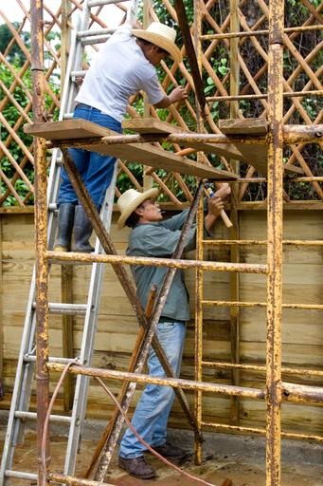
DISTRICT GRANT REPORTS
Submit final or interim reports by March 31
Copy all receipts
Pictures of the project
Email to Bettye Dunham bdunham@rauchinc.org
Notes:
Again, thank you for attending and be sure to contact one of us with any questions. You will receive an email tomorrow with a survey. Please reply to the survey to help us improve the process.
If your club is awarded a district grant for 2018-19, you will be required to submit the final report by March 31, 2019. If you project is not completed, you should submit an interim report by March 31. Submit a copy of all receipts and pictures of the project to District Grants Chair Bettye Dunham at bdunham@rauchinc.org

Slide 58
Session Poll
Notes:
. Now for the last set of polling questions.
Question 7
All of the following are true about reporting except:
-Final report is due on March 31st
-Documents should be retrained for 5 years
-Copy of all receipts and checks issued should be submitted at the time of the final report
X If the grant project is not completed by March 31st then no paperwork is due until August 31st
-If the grant project isn’t completed as described, funds must be returned to the District Foundation team.

Slide 59
KEY WEBSITES
http://www.rotary6580.org
Contains grant application and other forms, webinar PowerPoint, and other district grant documents
http://www.rotary.org
*Look under the Foundation Tab
*Go to the District Grants Tab
*Terms and Conditions of District Grants & Global Grants
You can Google anything you need
Notes:
The first web site is our district site and it contains the forms you will need, the application, MOU and other forms and a copy of this PowerPoint.
The second is a link to the RI learning and reference center. It contains a lot of information related to grants in general and training materials.
The third link is from the RI website to the communities in action newsletter which Peggy mentioned. It is a great place to see what clubs are doing and is a great source of ideas for projects.
The last is a link to the RI community assessment tool which Peggy also mentioned. It will help you determine the needs of your community to ensure that your project is a success..

Slide 60
KEY CONTACTS
Bettye Dunham—District Grants Chair: 502-609-1923 bdunham@rauchinc.org
Peggy Peter—Annual Fund Chair: 502-552-0342 prespeggy@aol.com
Jessika Hane—District Foundation Chair: 812-345-2256 Jessika@Hane.com
Bob Browning—Global Grants Chair: 317-213-1119 bbrowningcpa@gmail.com
Notes:
On this slide here is the contact information for the…..
I have shown the contact information for foundation team and the current and incoming governor. Any of these people would be happy to assist you in any way we can with regards to questions on grants or the Foundation in general.

Slide 61
QUESTIONS
2022-2023

Slide 62
Thank you!
Notes:
The is it. You are almost qualified so your club can get a District Grant. The final thing you must do is to complete the evaluation of the webinar for us. Your feedback is important so do not forget to go to the District Website and download the forms and send it to Bettye Dunham.
Thanks for your participation and good luck planning your local projects.

